Slide 1
Funding Opportunities

Slide 2
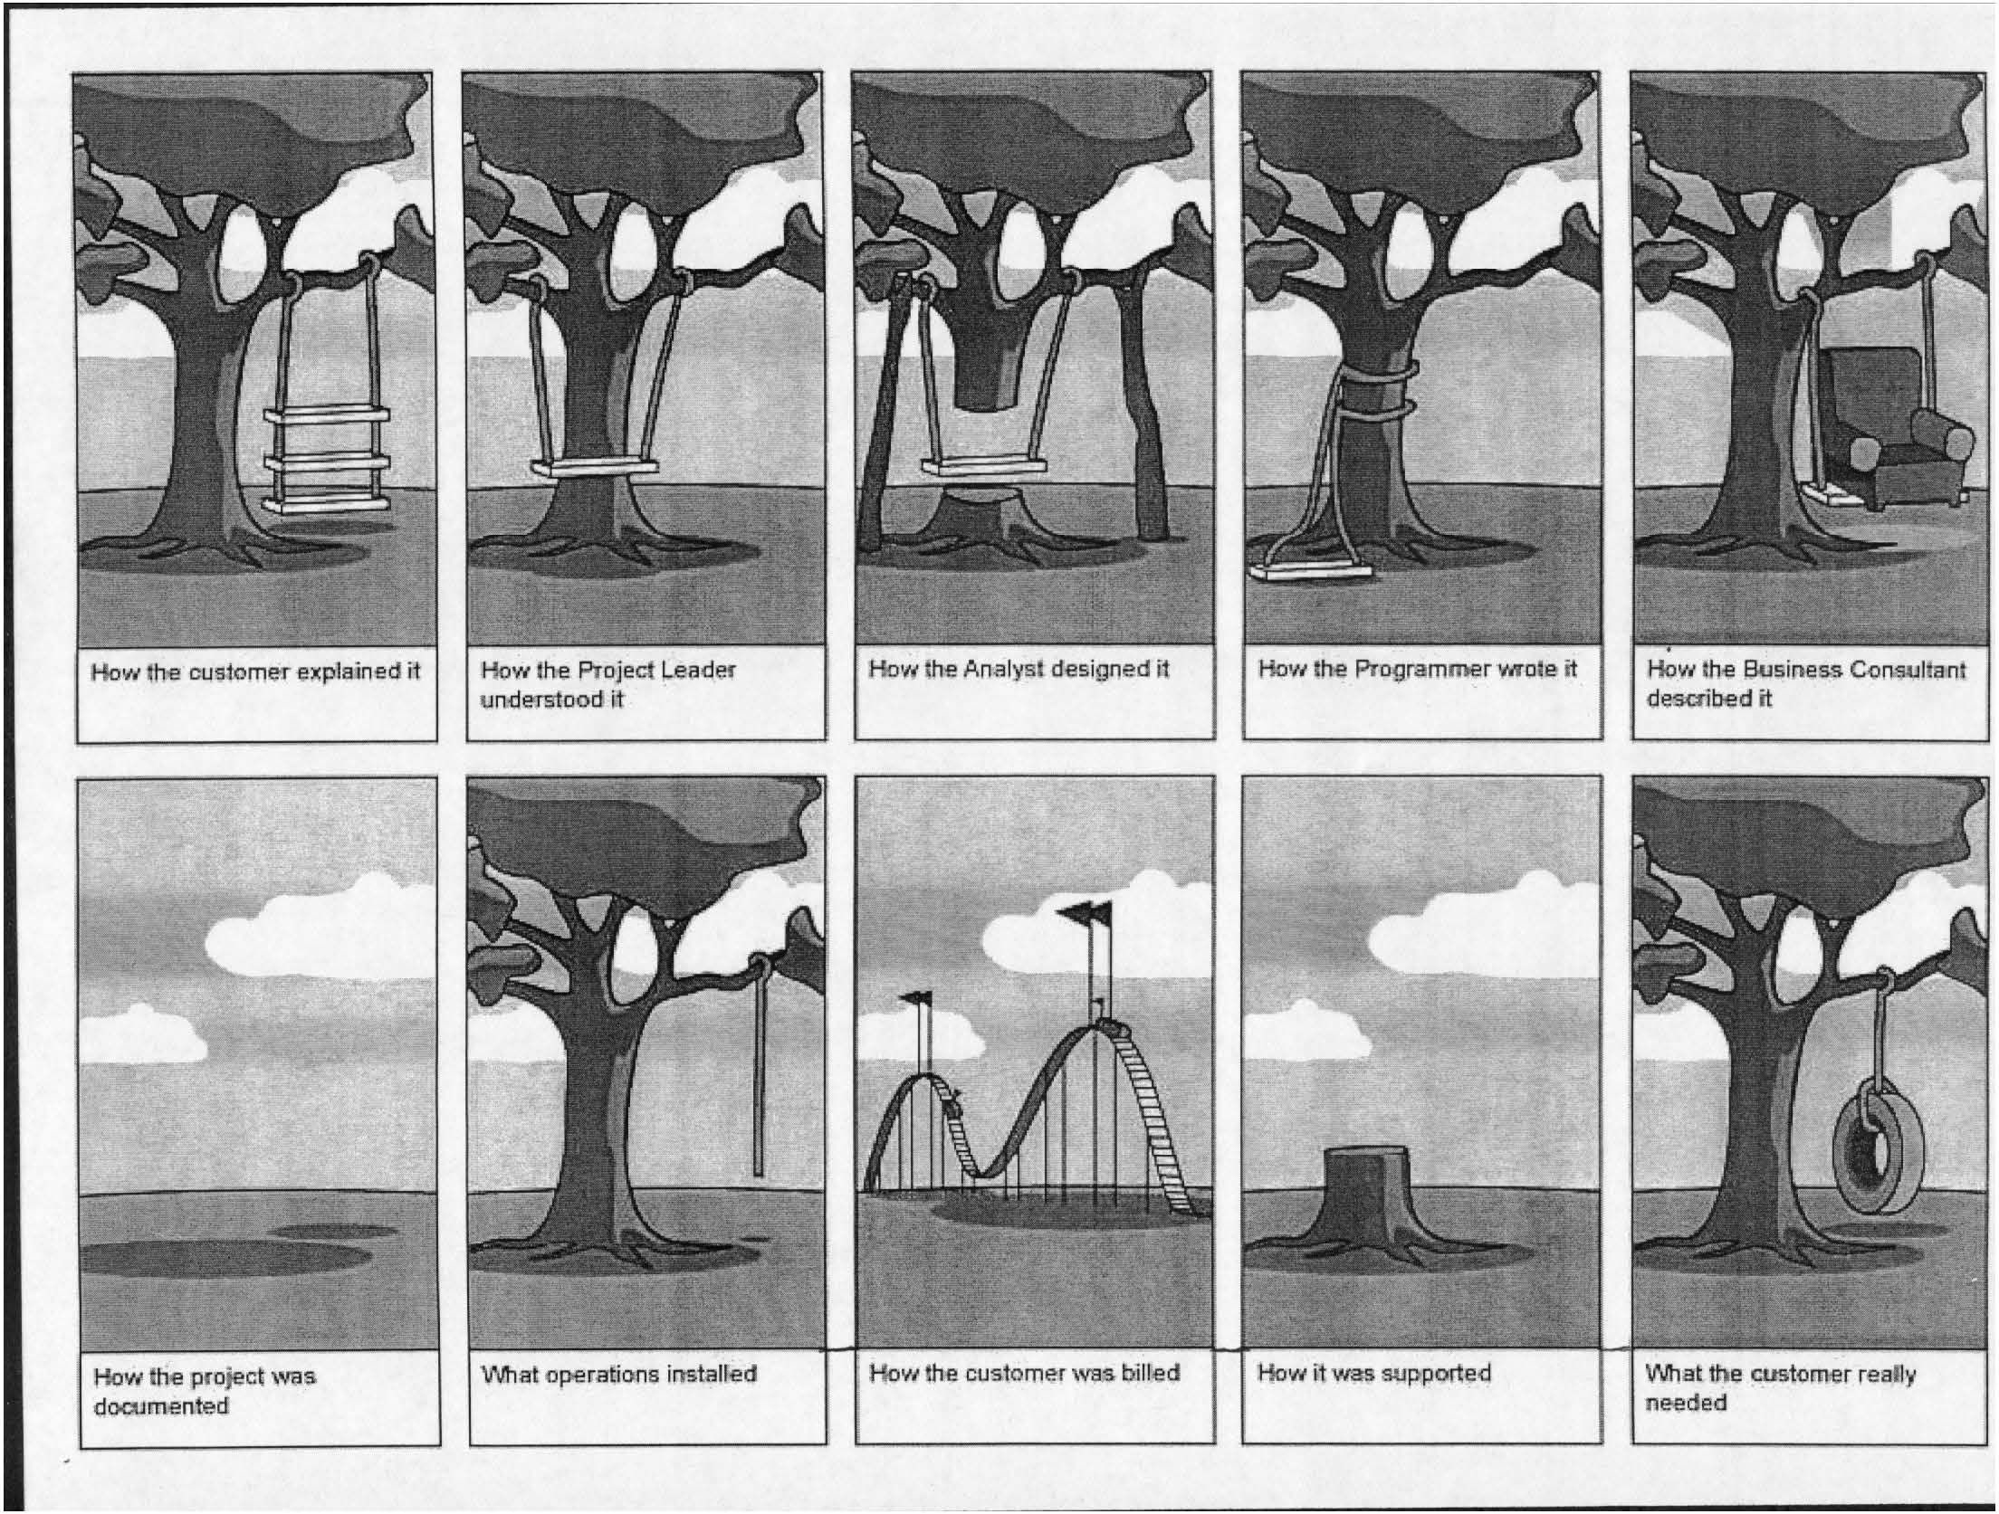

Slide 3
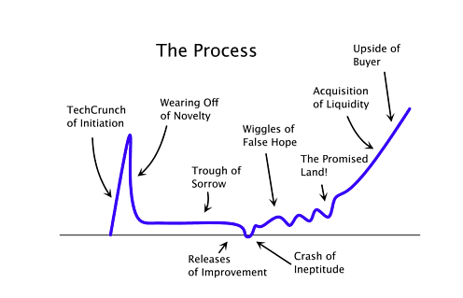
The Startup Curve

Slide 4
Getting Started – Seed Round
Bootstrapping - Do it yourself
Friends and Family (and fools)
Loans
Banks, SBA
Grants
Federal and State Governments

Slide 5
Bootstrapping
Starting a new business without start-up capital
Creative acquisition and use of resources
Some sources of bootstrap financing
credit cards
second mortgages
customer advances
internally generated retained earnings

Slide 6
Strategies for Bootstrapping
Get operational quickly.
Look for quick break-even, cash-generating products.
Offer high-value products or services that sustain direct personal selling.
Forget about the crack team.
Keep growth in check.
Focus on cash (not on profits, market share, or anything else).
Cultivate banks before the business becomes creditworthy (keep good books, immaculate records, and sound balance sheets from day one).

Slide 7
Equity v. Debt
EQUITY
DEBT
Common Stock
Straight Debt
Preferred Stock
Debt w/ warrants
Convertible Debt

Slide 8
Debt Capital
Must be repaid with interest.
Is carried as a liability on the company’s balance sheet.
Can be just as difficult to secure as equity financing.
Can be expensive, especially for small companies, because of the risk/return tradeoff.

Slide 9
Sources of Debt Capital
Commercial Banks
Stock brokerage houses
Insurance companies
Credit unions
Bonds
Private placements
Small Business Investment/Lending Companies (SBICs/SBLCs)

Slide 10
Commercial Banks
Short-term loans
Commercial loans
Lines of credit
Intermediate and long-term loans
Installment loans and contracts

Slide 11
Asset-Based Borrowing
Businesses borrow money by pledging as collateral otherwise idle assets
accounts receivable
inventory
Advance rate – the percentage of an asset’s value that a lender will lend.

Slide 12
Federally Sponsored Programs
Economic Development Administration (EDA)
Department of Housing and Urban Development (HUD)
U.S. Department of Agriculture’s Rural Business-Cooperative Service
Small Business Innovation Research (SBIR)
Small Business Technology Transfer programs
Small Business Administration (SBA)

Slide 13
SBA Loan Programs
Low Doc Loan Program
SBAExpress Program
7(A) Loan Guaranty Program
the most popular SBA loan program

Slide 14
Term Sheet
a short and readable summary of the key terms of an equity financing, typically addresses the following issues:
Company Valuation, Company Ownership
Liquidation Preferences
Lock-Up Provisions
Additions to Management Team, Employment
Anti Dilution Rights, Tag Along and Drag Along Rights
Right of First Refusal
Confidentiality and IP Agreements
Redemption Rights, Registration Rights, Information Rights
Voting Rights, Board Positions
Stock Conversion, Vesting Periods
Use of Proceeds
Stock Options Pool
Warranties

Slide 15
Convertible Note
Loan with an interest rate
Usually 4-8%, 12-24 months
Can be repaid with money
or exchanged for stock of the company at the option of the lender (investor).
Common Terms
Conversion Discount to next round (10-40%)
Conversion Cap

Slide 16
Convertible Note: Example
Seed Round Terms:
$100,000 note, 6% interest, 24 months, 20% discount, conversion cap of $2,500,000
If A Round valuation = $5,000,000 (post)
Investor will get 4% of stock (100K/2.5MM)
If A Round valuation = $1,250,000 (post)
Investor will get 10% of stock (100K/1MM)

Slide 17
Convertible Note
Advantages
Postpones valuation question
Less due diligence
Less documentation = lower legal costs
Speed
Disadvantages
Debt, must be repaid

Slide 18
Equity Capital
Represents the personal investment of the owner(s) in the business.
Is called risk capital because investors assume the risk of losing their money if the business fails.
Does not have to be repaid with interest like a loan does.
Means that an entrepreneur must give up some ownership in the company to outside investors.

Slide 19
Sources of Equity Financing
Personal savings
Friends and family members
Angels
Partners
Corporations
Venture capital companies
Public stock sale

Slide 20

Personal Savings
The first place an entrepreneur should look for money.
The most common source of equity capital for starting a business.
Outside investors and lenders expect entrepreneurs to put some of their own “skin in the game” before investing theirs.

Slide 21
Friends and Family
After emptying their own pockets, entrepreneurs should turn to those most likely to invest in the business:
Friends and Family members
Careful!!! Inherent dangers lurk in family/friendly business deals, especially those that flop.

Slide 22
Friends and Family
Guidelines for family and friendship financing:
Consider the impact of the investment on everyone involved.
Keep the arrangement “strictly business.”
Settle the details up front.
Never accept more than investors can afford to lose.
Create a written contract.
Treat the money as “bridge financing.”
Develop a payment schedule that suits both parties.
Have an exit plan.

Slide 23
Common Stock
Right to receive dividends
Voting rights
Liquidation - last in line

Slide 24
Preferred Stock
Preferred dividends – paid before common
Declared rate – 4-10%
Liquidation preference – usually 1x
Usually has RFR, Tag/Drag Along, Anti-Dilution

Slide 25
Liquidation Preference Ex. #1
Investor makes $1,000,000 investment for 50% stake with 2x non‐participating liquidation preference.
“Either-or” scenario, investor get either the preferred stock value or converts to common
Exit scenarios:
$2,000,000 exit: Investor gets all proceeds
$3,000,000 exit: Investor gets $2,000,000; common gets $1,000,000
$5,000,000 exit: Investor would convert to common before closing and get $2,500,000; common gets $2,500,000

Slide 26
Liquidation Preference Ex. #2
Investor makes $1,000,000 investment for 50% stake with 2x participating liquidation preference.
“And” scenario, investor gets both preferred and common stock values
Exit scenarios:
$2,000,000 exit: Investor gets all proceeds
$3,000,000 exit: Investor gets $2,500,000; common gets $500,000. Investor gets first $2,000,000, and then investor participates (50% share) in remaining $1,000,000.
$5,000,000 exit: Investor gets $3,500,000; common gets $1,500,000. Investor gets first $2,000,000, and then investor participates (50% share) in remaining $3,000,000.

Slide 27
Angels
Private investors who invest in emerging entrepreneurial companies.
Fastest growing segment of the small business capital market.
Excellent source of “patient money”
From $50,000 up to $1,000,000

Slide 28
Angels
An estimated 230,000 angels across the U.S. invest $23 billion a year in 50,000 small companies.
Their investments exceed those of venture capital firms, providing more capital to 17 times as many small companies.

Slide 29
Corporate Venture Capital
20% of all venture capital investments come from corporations.
About 300 large corporations worldwide invest in start-up companies.
Other benefits: corporate partners may share marketing and technical expertise.

Slide 30
Venture Capital Companies
More than 1,300 venture capital firms operate across the U.S.
Most invest from $2 to $20 million
Seeking high-growth and high-profit potential.
Business plans are subjected to an extremely rigorous review - less than 1 percent accepted.

Slide 31
Funding Rounds
Seed Round – Friends & Family
$1-$50,000
Prototype, secure IP
A Round – Angel Investors
$50,000- $1,000,000
Prove the concept, establish revenue
B Round - Venture Capitalists
$2,000,000 - $20,000,000
Scale, grow the business
Series A, B, etc. as needed

Slide 32
Harvest
Lifestyle
Sale / Merger
Initial Public Offering (IPO)

Slide 33

Going Public
Initial public offering (IPO)
when a company raises capital by selling shares of its stock to the public for the first time.
Typical year:
about 410 companies make IPOs.
Few companies with sales below $20 million in annual sales make IPOs.

Slide 34
Successful IPO Candidates
Consistently high growth rates
Strong record of earnings
3 to 5 years of audited financial statements that meet or exceed SEC standards
Solid position in a rapidly growing industry
Sound management team with experience and a strong board of directors

Slide 35
Advantages of “Going Public”
Ability to raise large amounts of capital
Improved corporate image
Improved access to future financing
Attracting and retaining key employees
Using stock for acquisitions
Listing on a stock exchange

Slide 36
Disadvantages of “Going Public”
Dilution of founder’s ownership
Loss of control
Loss of privacy
Reporting to the SEC
Filing expenses
Accountability to shareholders
Pressure for short-term performance
Timing

Slide 37
Sample Ask – Preferred Equity
Seed Round of $250,000
Preferred Stock
1.25 million pre-money valuation
6% preferred dividend
1x liquidation preference
Gets us 18-24 months of operations
We have $60,000 committed from 2 investors

Slide 38
Sample Ask – Convertible Debt
Seed Round of $50,000
Convertible note (4%, 20% discount)
Gets us 8-10 months of operations
Assumes revenue begins in month 5
We have $25,000 committed from 2 investors
Two tranches
First now
Second when we launch in month 5

Slide 39
Assignment
Create 1-page Executive Summary
1. Create an Entrepreneur Account on www.gust.com
2. In the private site, create the Company Profile and Business Summary
3. On the Dashboard tab, click on “Download your one pager”, save a copy for yourself.
4. Upload the copy of Learning Suite.
Due in 2 weeks

